Slide 1
M- WAY TREES
ADITYA TIWARI
ASSISTANT PROFESSOR
CSVTU, BHILAI

Slide 2
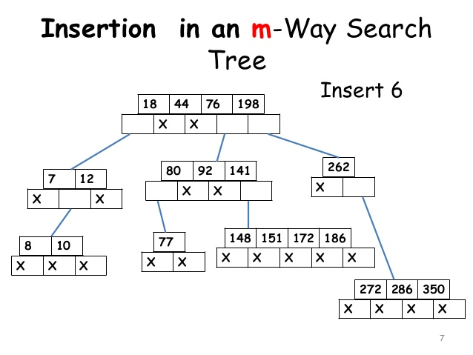

Slide 3
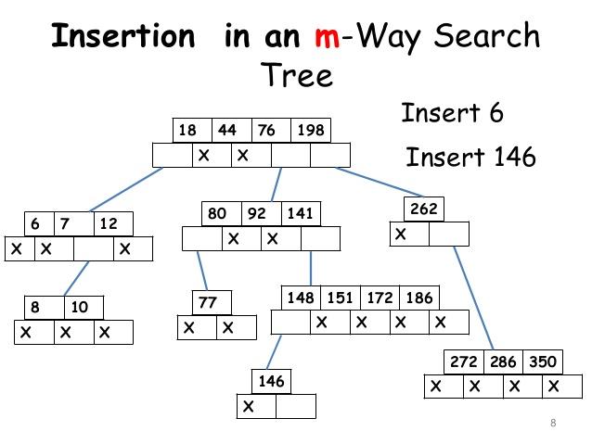

Slide 4
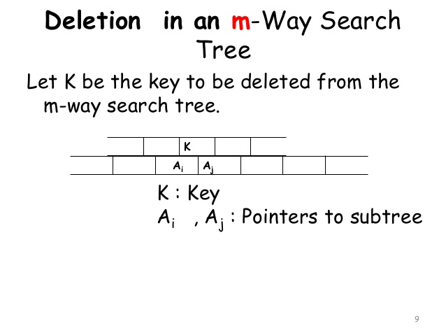

Slide 5
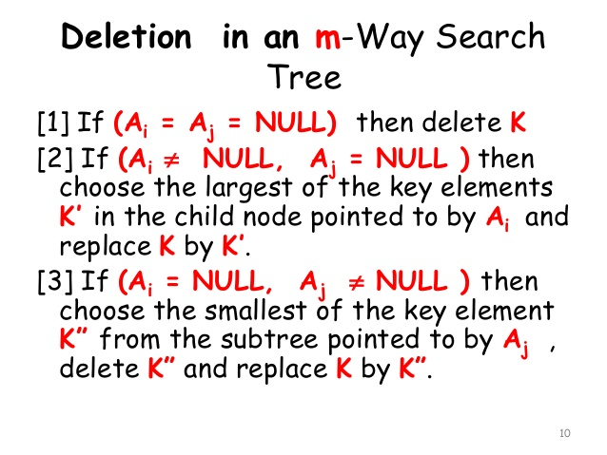

Slide 6
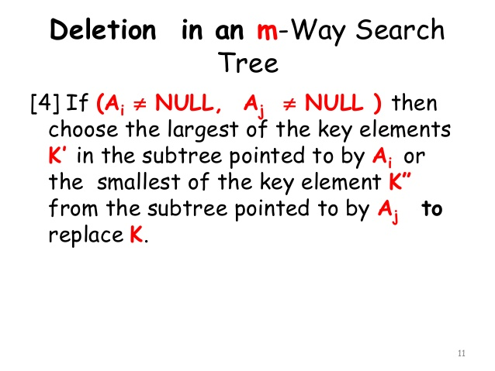

Slide 7
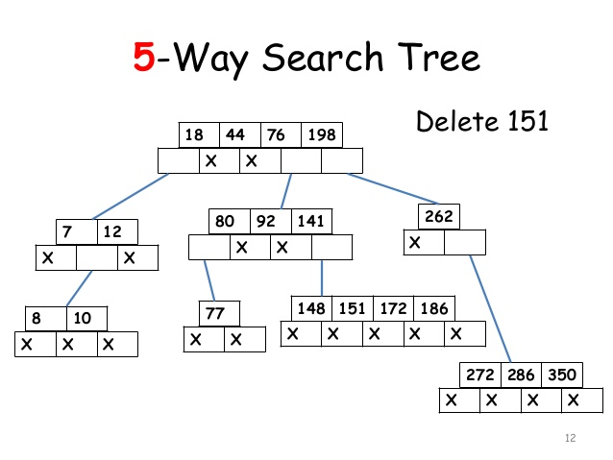

Slide 8
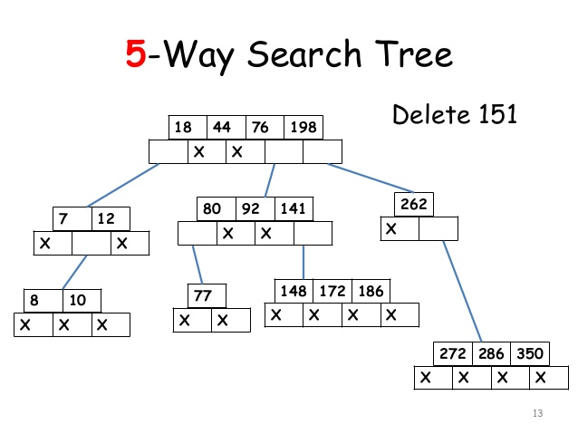

Slide 9


Slide 10
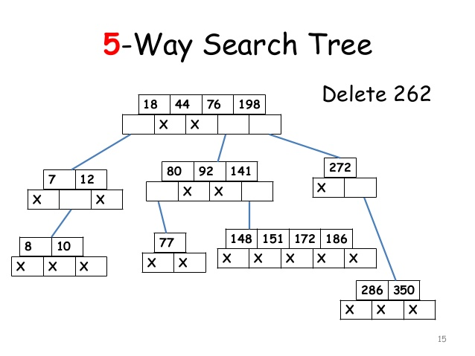

Slide 11


Slide 12
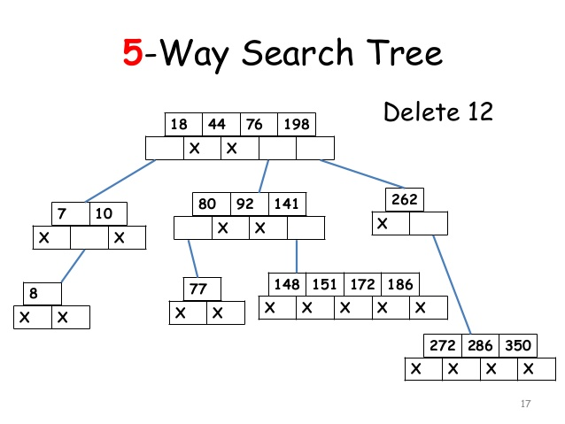

Slide 13
B Tree Introduction
B Tree is a specialized m-way tree that can be widely used for disk access. A B-Tree of order m can have at most m-1 keys and m children. One of the main reasons of using B tree is its capability to store large number of keys in a single node and large key values by keeping the height of the tree relatively small.
A B tree of order m contains all the properties of an M way tree. In addition, it contains the following properties.

Slide 14
1. Every node in a B-Tree contains at most m children.
2. Every node in a B-Tree except the root node and the leaf node contain at least m/2 children.
3. The root nodes must have at least 2 child nodes.
4. All leaf nodes must be at the same level.
It is not necessary that, all the nodes contain the same number of children but, each node must have m/2 number of nodes.
A B tree of order 4 is shown in the following image.

Slide 15
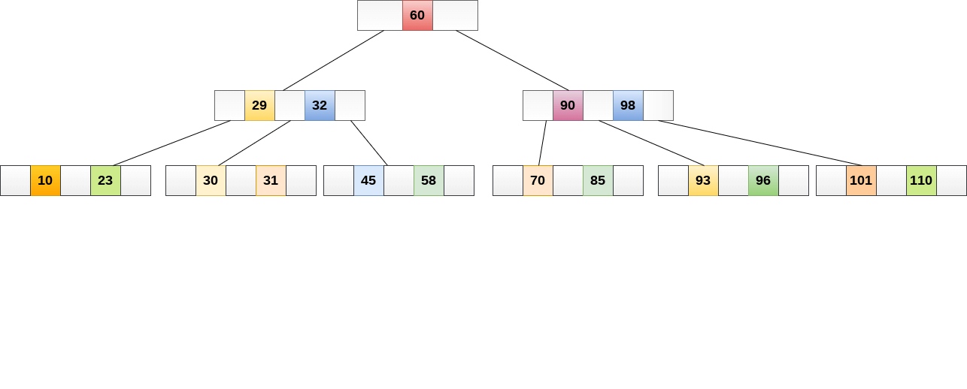

Slide 16
While performing some operations on B Tree, any property of B Tree may violate such as number of minimum children a node can have. To maintain the properties of B Tree, the tree may split or join.

